Slide 1

Minimum Wage Legislation and Tertiary Education Attainment
Tweets welcome: @ChrisMarsicano @vupeabody @BelmontMassey #minimumwage #CIES2018
Financing Higher Education
Tue, March 27, 8:00 to 9:30am,
Hilton Reforma, 2nd Floor, Don Diego 1 Section C

Slide 2
Outline for Talk
Background
Research Question
Theory of Action
Data and Methods
Results
Discussion and Conclusions

Slide 3
Background - Minimum Wage Studies
Research on the minimum wage:
No shortage of research on labor, employment effects. _{(Card & Krueger, 1994;} Neumark & Wascher, 2000; Hoffman & Trace, 2009; Jardim et al. 20017; Reich, Allegretto, & Godoey, 2017)
Growing body of work on minimum wage legislation as poverty alleviation. (Sabia & Burkhauser, 2010; Middleton, 1993)
Dearth of research on education outcomes. (Mattila, 1981; Brown, Gilroy, & Kohen, 1981; Campolieti, Fang, & Gunderson, 2005; Cunningham, 1981; Pacheco & Cruickshank, 2007, Turner & Demiralp, 2000)

Slide 4
Background - Recent Work
Recent Findings on the Minimum Wage in the United States:
Minimum wage level, community college enrollment positively related. _{(Marsicano & Kramer, 2017)}
OLS regression models show significant relationship between minimum wages & enrollment.
2007 minimum wage increase caused enrollment increase in North Carolina. _{(Marsicano & Kramer, 2017)}
Difference-in-Differences model show:
$1.00 increase yields ~20% increase in enrollment, ~35% increase at MSIs
2016 Seattle Minimum Wage increase (Marsicano, Kramer, & Kramer, 2017)
Difference-in-Differences model and Synthetic Controls show:
~20% decrease in enrollment, except for at South Seattle College
South Seattle College is an AANAPISI

Slide 5
Research Question
To our knowledge, little research on relationship between minimum wage legislation and tertiary enrollment in the non-US context.
What is the relationship between the minimum wage and tertiary attainment across national contexts?

Slide 6
Theory of Action
Potential Students
ENROLL
Decision to Improve
Human Capital
DO NOT ENROLL
Job Status
Financial Liquidity
Minimum Wage Increase
Notes:
Prospective postsecondary college students must carefully weigh the decision of whether or not to invest in human capital development.
Regardless of the minimum wage status or discourse, some students will choose to enroll and others will not.
We’re interested instead in those students at the margins of enrollment who may base their HC investment decision based on consideration of their job status and financial liquidity.
Both financial liquidity and job status stand to change with an exogenous policy change, a minimum wage increase.
We can imagine a minimum wage increase may contributing to two different outcomes, with a number of different potential underlying mechanisms for each.

Slide 7
Data and Methods
Data
Country level data from OECD, World Bank
2001 - 2016
Methods
Descriptive Analysis
OLS Regression

Slide 8
Data and Methods
Model:
Y_{it}= α + β_{it} + X_{it} + δ_{it} + ρ_{t} + ε_{it}
_{where,}
Y is the tertiary enrollment (% gross) for country i, in year t
β is the variable of interest – log(minimum wage)
X is a vector of national-level economic variables
δ is a vector of national-level education variables
ρ is a year fixed effect
α is the constant, and ε is the error term

Slide 9
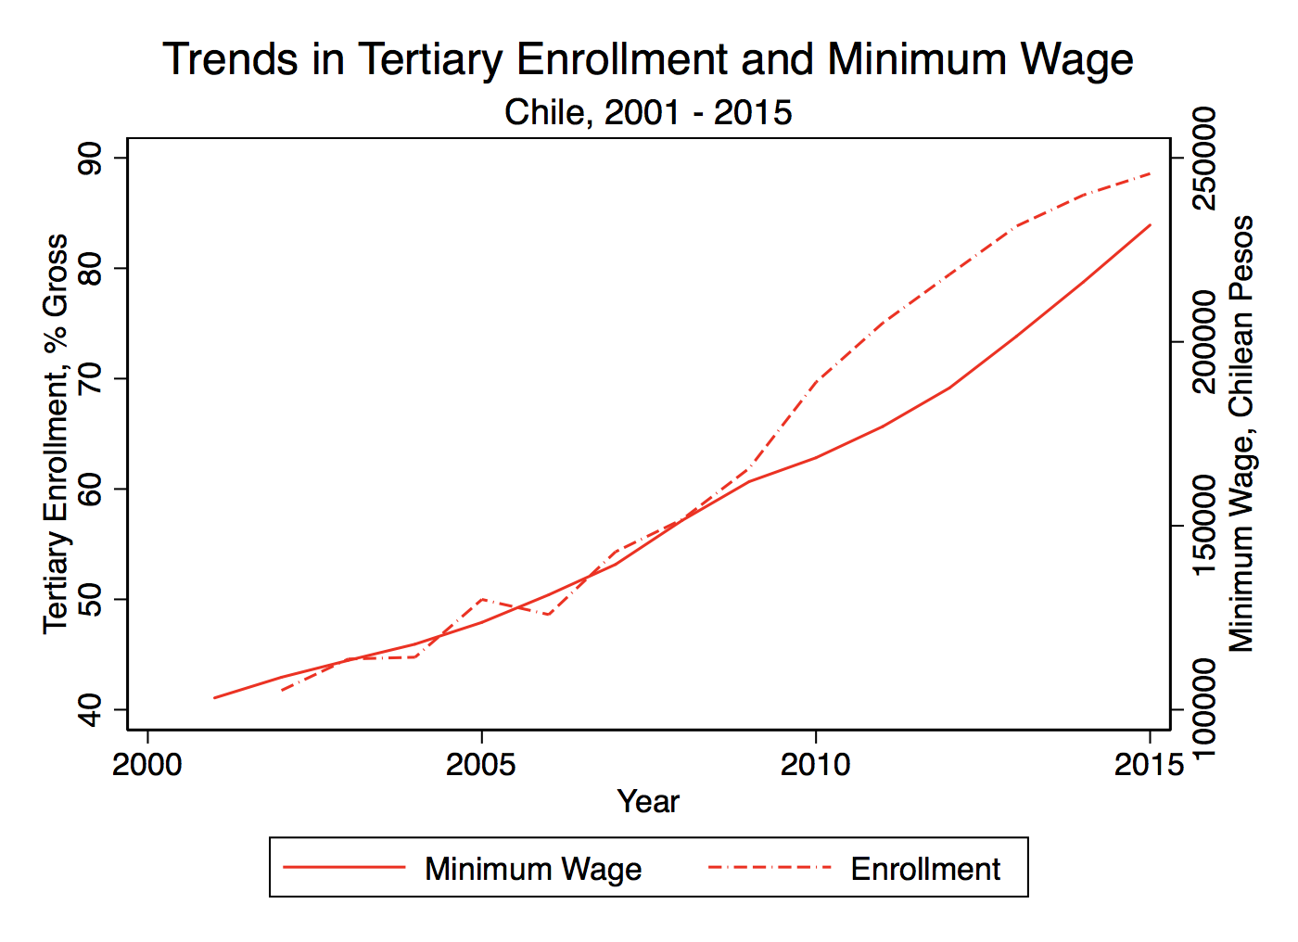
Results

Slide 10
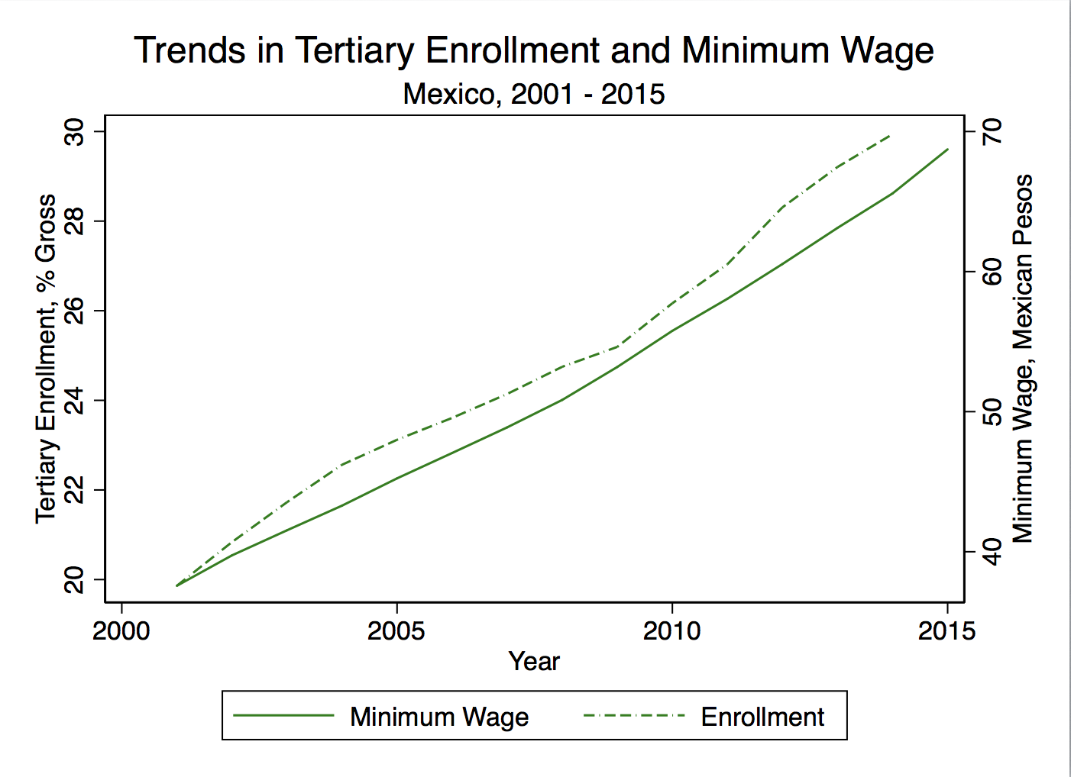
Results

Slide 11
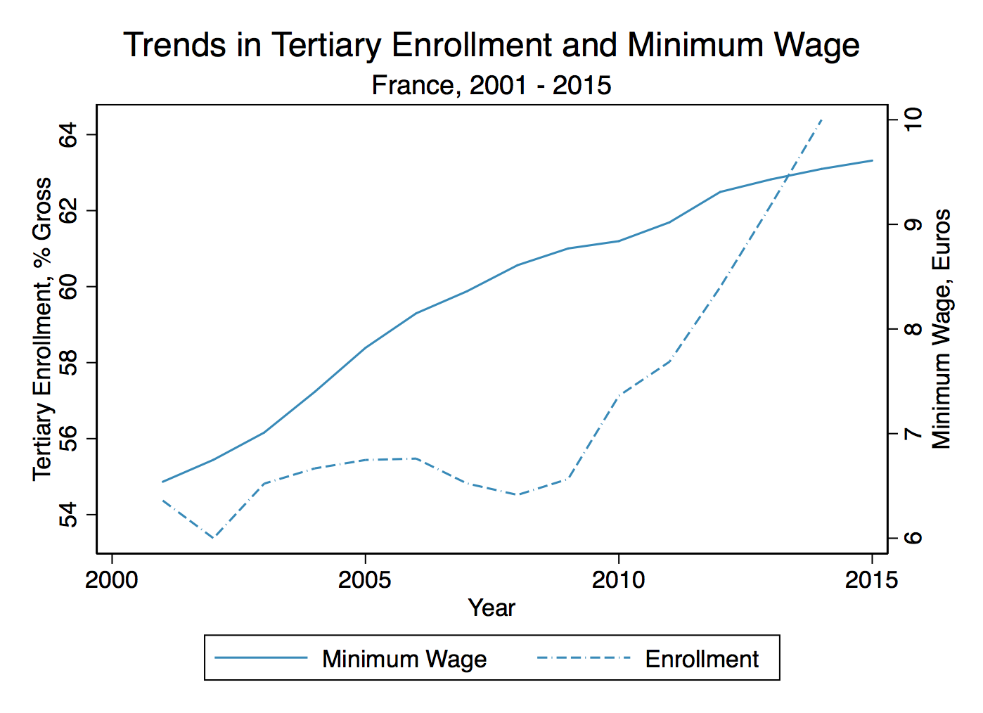
Results

Slide 12
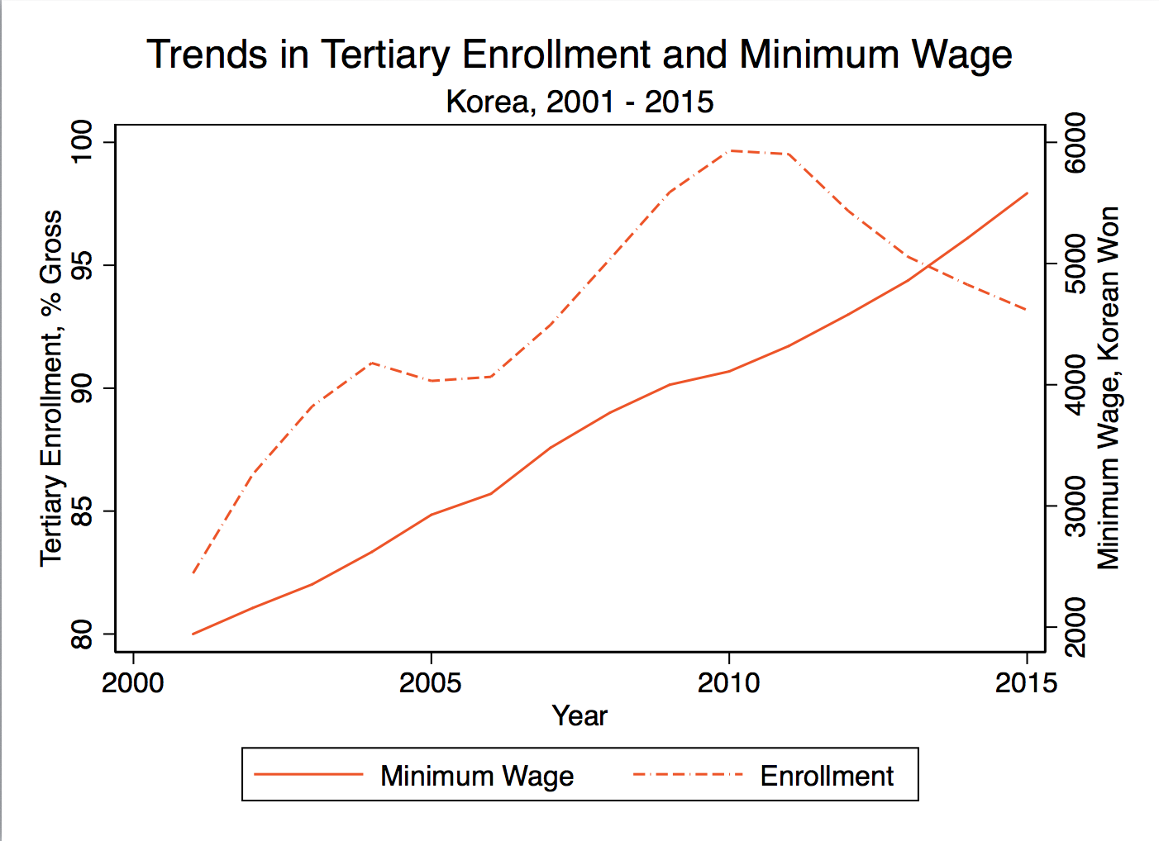
Results

Slide 13
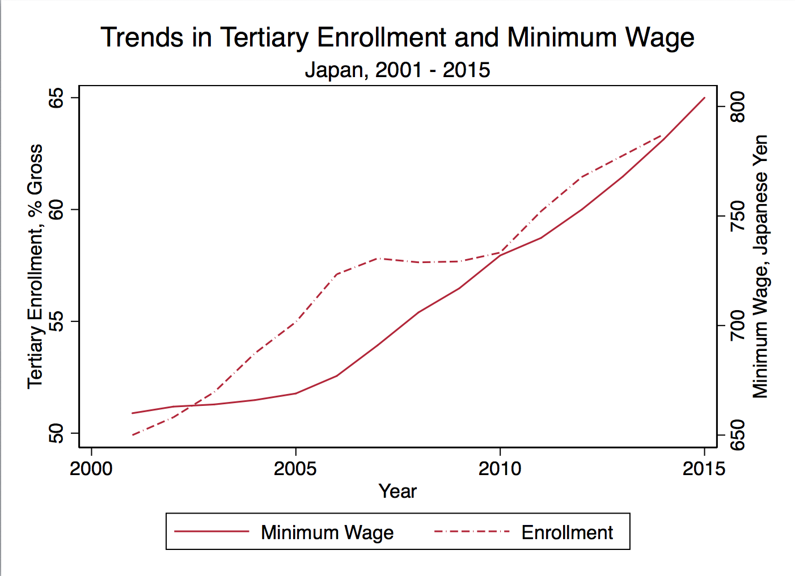
Results

Slide 14
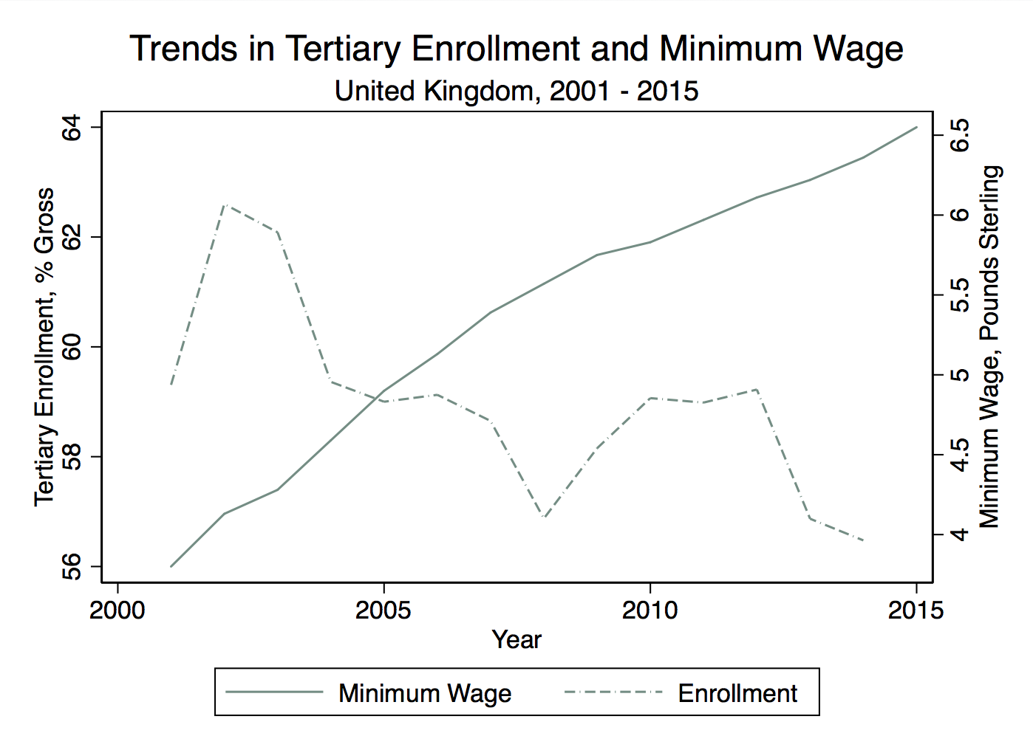
Results

Slide 15
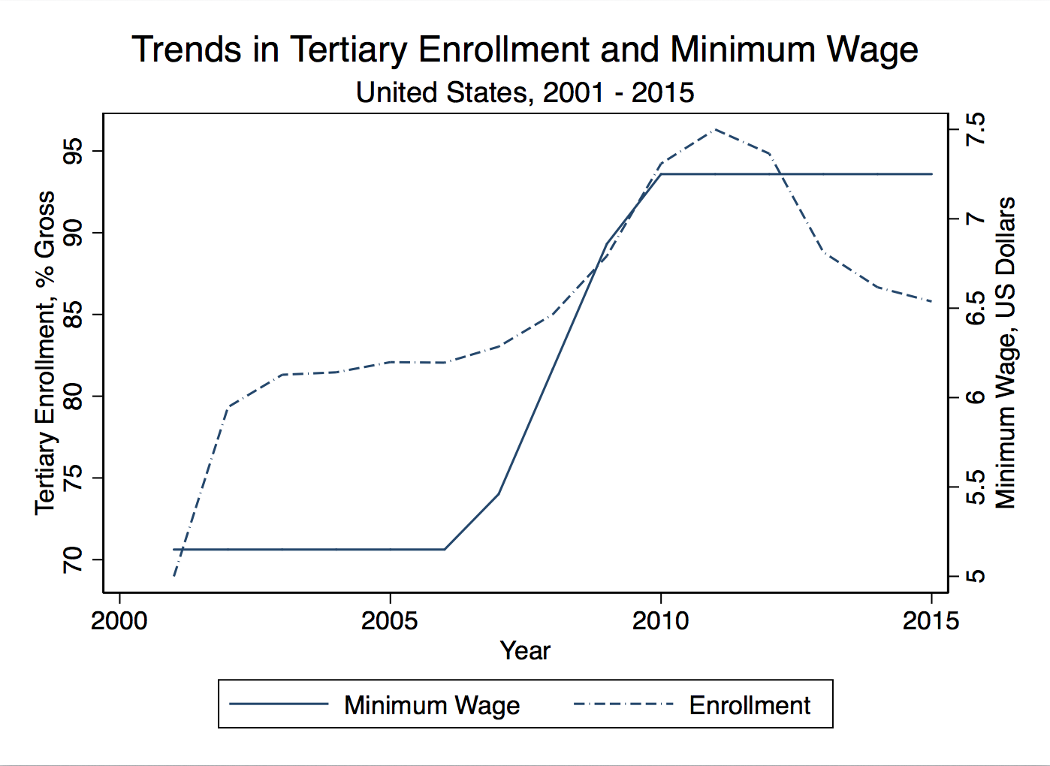
Results

Slide 16
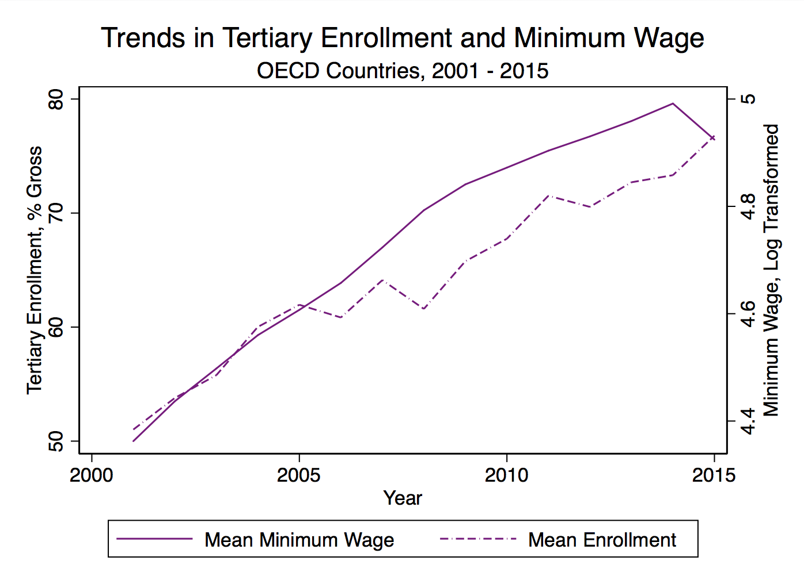
Results

Slide 17
Results

Slide 18
Discussion and Conclusion
Across countries minimum wage is linked to tertiary attainment
β = 2.83**
Limitations
Relational, not causal
Investment in higher education may coincide with minimum wage increase
Part of the platforms of Center-Left, Leftist, Social Democratic political parties
Sub-national minimum wages – Imprecise measure

Slide 19
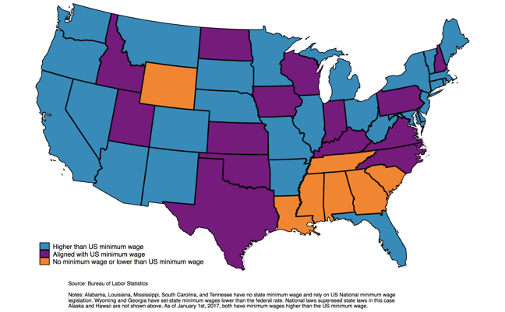
Discussion and Conclusion

Slide 20
Questions or Comments?
Dr. Marieta Velikova
Belmont University
marieta.velikova@belmont.edu
@BelmontMassey
Christopher R. Marsicano
Vanderbilt University
christopher.marsicano@vanderbilt.edu
@ChrisMarsicano

